Slide 1
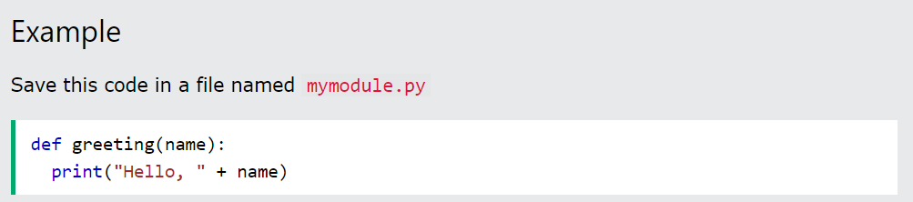
What is a Module?
Consider a module to be the same as a code library.
A file containing a set of functions you want to include in your application.
Create a Module
To create a module just save the code you want in a file with the file extension .py:

Slide 2
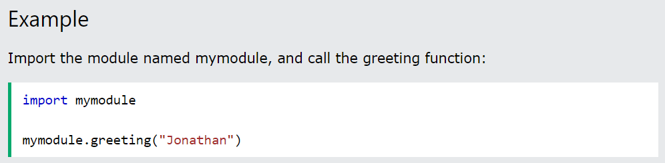
Use a Module
Now we can use the module we just created, by using the import statement:
Note: When using a function from a module, use the syntax: module_name.function_name.

Slide 3
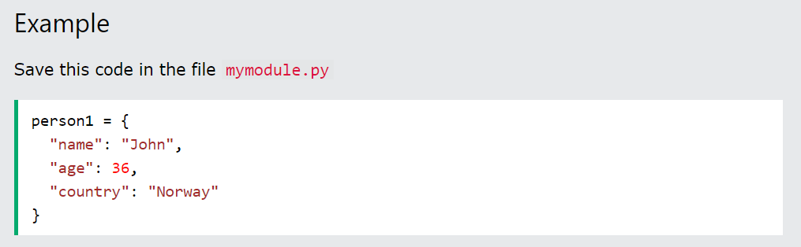
Variables in Module
The module can contain functions, as already described, but also variables of all types (arrays, dictionaries, objects etc):

Slide 4
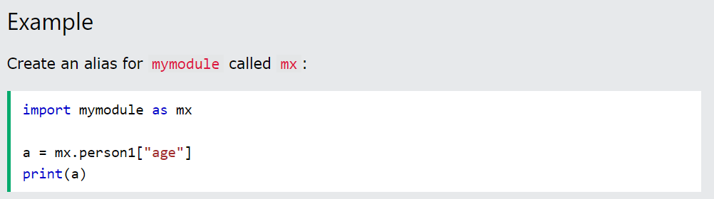
Naming a Module
You can name the module file whatever you like, but it must have the file extension .py
Re-naming a Module
You can create an alias when you import a module, by using the as keyword:

Slide 5
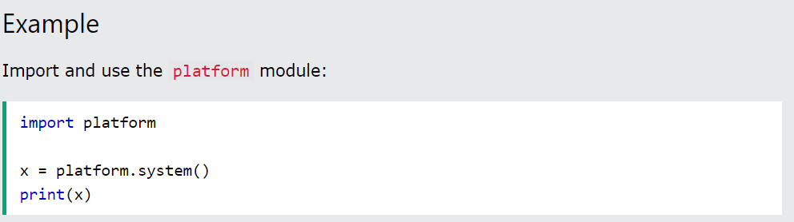
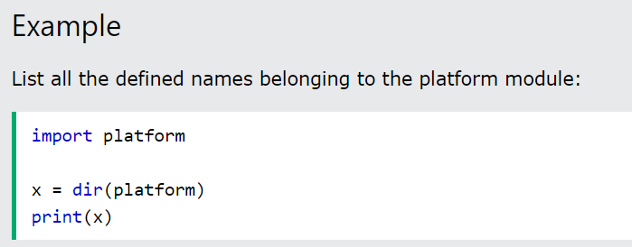
Built-in Modules
There are several built-in modules in Python, which you can import whenever you like.
Using the dir() Function
There is a built-in function to list all the function names (or variable names) in a module. The dir() function:

Slide 6
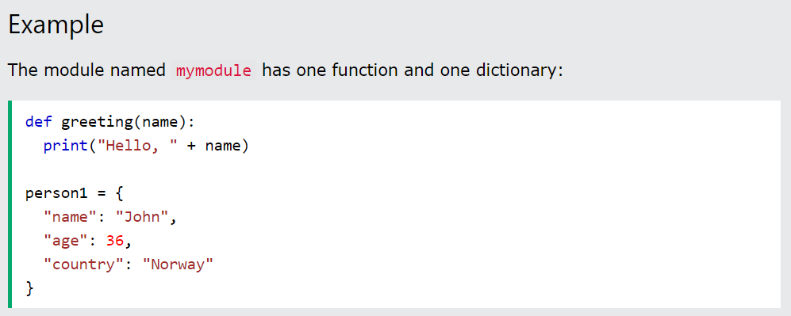
Import From Module
You can choose to import only parts from a module, by using the from keyword.

Slide 7
Python PIP
What is PIP?
PIP is a package manager for Python packages, or modules if you like.
Note: If you have Python version 3.4 or later, PIP is included by default.
What is a Package?
A package contains all the files you need for a module.
Modules are Python code libraries you can include in your project.

Slide 8
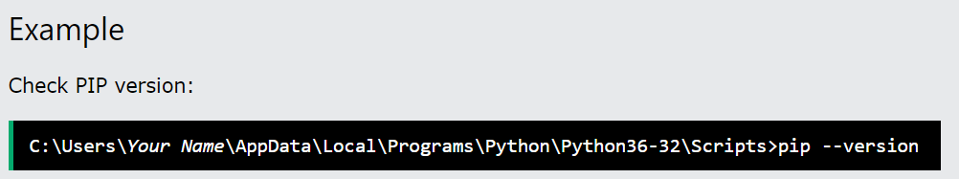
Check if PIP is Installed
Navigate your command line to the location of Python's script directory, and type the following:

Slide 9
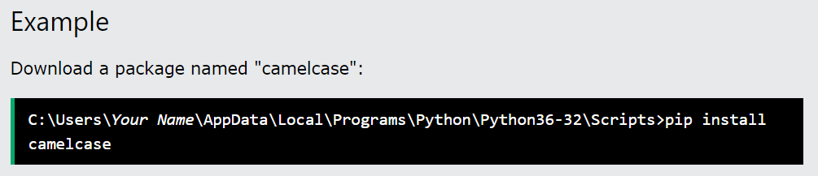
Install PIP
If you do not have PIP installed, you can download and install it from this page: https://pypi.org/project/pip/
Download a Package
Downloading a package is very easy.
Open the command line interface and tell PIP to download the package you want.
Navigate your command line to the location of Python's script directory, and type the following:

Slide 10
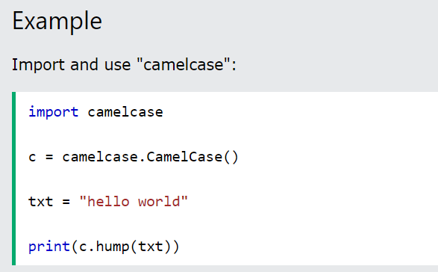
Using a Package
Once the package is installed, it is ready to use.
Import the "camelcase" package into your project.

Slide 11
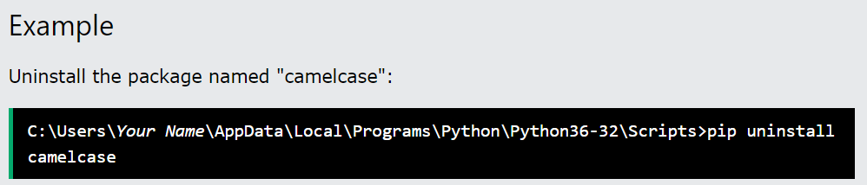
Remove a Package
Use the uninstall command to remove a package:
The PIP Package Manager will ask you to confirm that you want to remove the camelcase package
Press Y and the package will be removed.

Slide 12
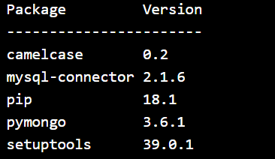
List Packages
Use the list command to list all the packages installed on your system:
Example
List installed packages:
Result :

Slide 13
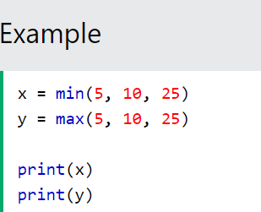
Python Math
Python has a set of built-in math functions, including an extensive math module, that allows you to perform mathematical tasks on numbers.
Built-in Math Functions
The min() and max() functions can be used to find the lowest or highest value in an iterable:

Slide 14
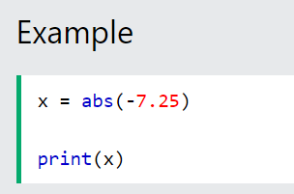

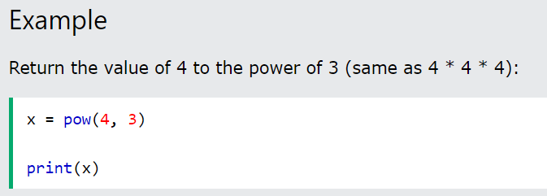

The abs() function returns the absolute (positive) value of the specified number:
The pow(x, y) function returns the value of x to the power of y (x^{y}).

Slide 15
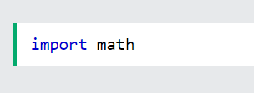
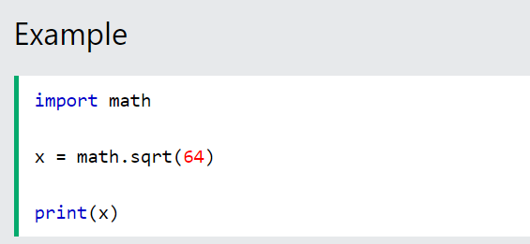
The Math Module
Python has also a built-in module called math, which extends the list of mathematical functions.
To use it, you must import the math module:
When you have imported the math module, you can start using methods and constants of the module.
The math.sqrt() method for example, returns the square root of a number:

Slide 16
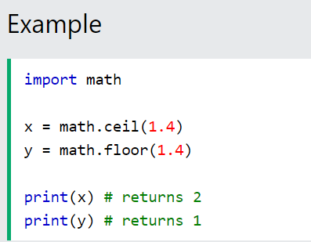
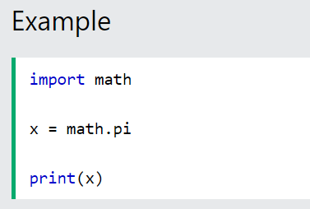
The math.ceil() method rounds a number upwards to its nearest integer, and the math.floor() method rounds a number downwards to its nearest integer, and returns the result:
The math.pi constant, returns the value of PI (3.14...):

Slide 17
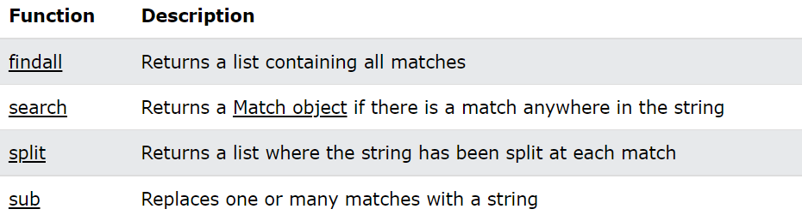
RegEx Functions
The re module offers a set of functions that allows us to search a string for a match:

Slide 18

A RegEx, or Regular Expression, is a sequence of characters that forms a search pattern.
RegEx can be used to check if a string contains the specified search pattern.
RegEx Module
Python has a built-in package called re, which can be used to work with Regular Expressions.
Import the re module

Slide 19
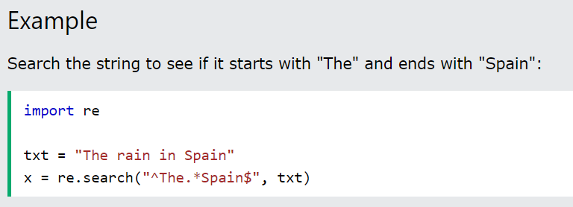
RegEx in Python
When you have imported the re module, you can start using regular expressions:

Slide 20
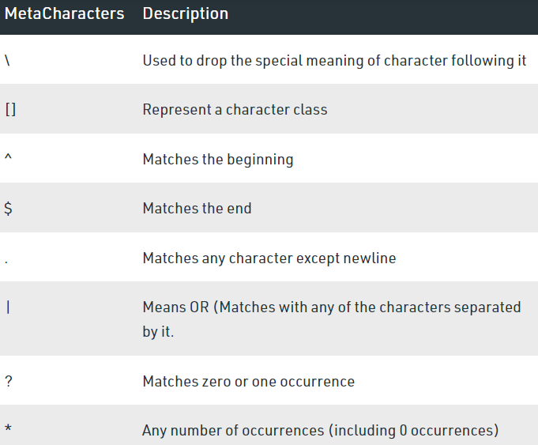
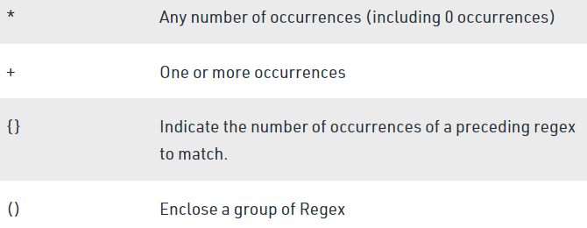
MetaCharacters
To understand the RE analogy, MetaCharacters are useful, important, and will be used in functions of module re. Below is the list of metacharacters.

Slide 21
\ – Backslash
The backslash (\) makes sure that the character is not treated in a special way. This can be considered a way of escaping metacharacters
[] – Square Brackets
Square Brackets ([]) represents a character class consisting of a set of characters that we wish to match. For example, the character class [abc] will match any single a, b, or c.
We cal also specify a range of characters using – inside the square brackets. For example,
[0, 3] is sample as [0123]
[a-c] is same as [abc]

Slide 22
^ – Caret
Caret (^) symbol matches the beginning of the string i.e. checks whether the string starts with the given character(s) or not. For example –
^g will check if the string starts with g such as geeks, globe, girl, g, etc.
^ge will check if the string starts with ge such as geeks, etc
$ – Dollar
Dollar($) symbol matches the end of the string i.e checks whether the string ends with the given character(s) or not
+ – Plus
Plus (+) symbol matches one or more occurrences of the regex preceding the + symbol

Slide 23
. – Dot
Dot(.) symbol matches only a single character except for the newline character (\n)
| – Or
Or symbol works as the or operator meaning it checks whether the pattern before or after the or symbol is present in the string or not.
? – Question Mark
Question mark(?) checks if the string before the question mark in the regex occurs at least once or not at all
* – Star
Star (*) symbol matches zero or more occurrences of the regex preceding the * symbol

Slide 24
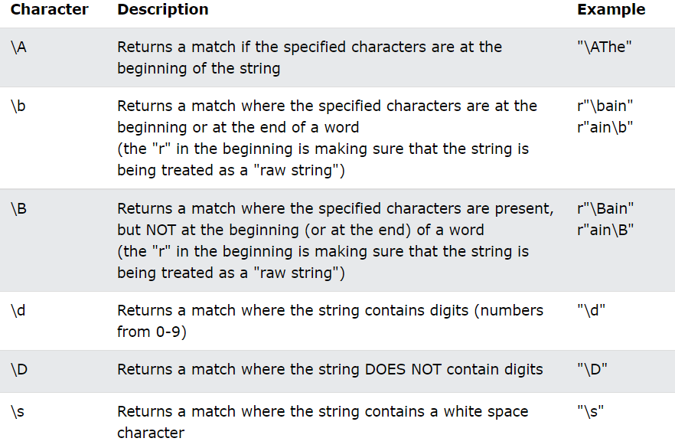
Special Sequences
Special sequences do not match for the actual character in the string instead it tells the specific location in the search string where the match must occur. It makes it easier to write commonly used patterns.

Slide 25
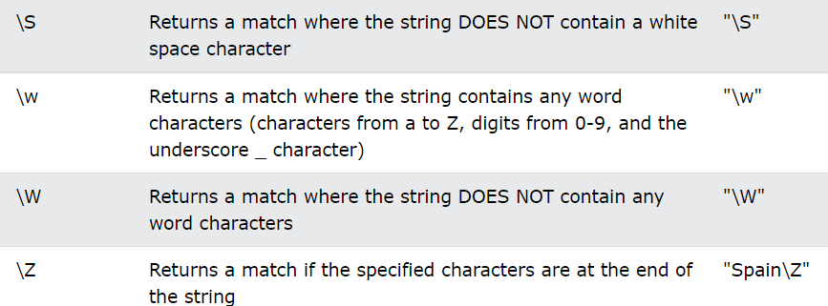

Slide 26
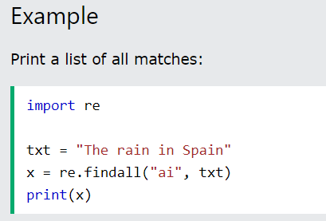
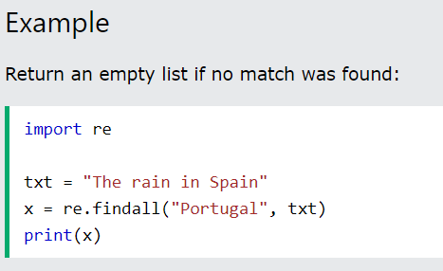
The findall() Function
The findall() function returns a list containing all matches.
The list contains the matches in the order they are found.
If no matches are found, an empty list is returned:

Slide 27
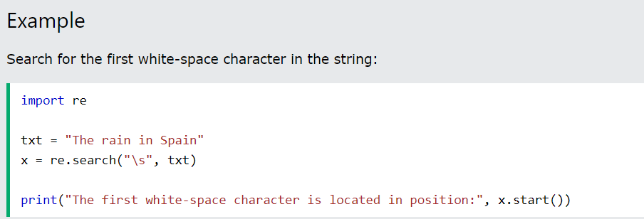
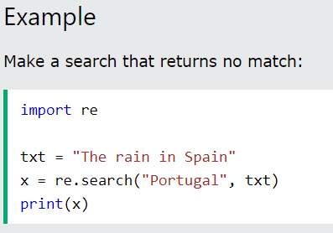
The search() Function
The search() function searches the string for a match, and returns a Match object if there is a match.
If there is more than one match, only the first occurrence of the match will be returned:
If no matches are found, the value None is returned:

Slide 28
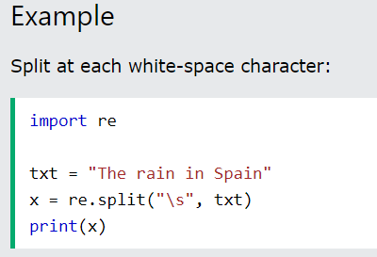
The split() Function
The split() function returns a list where the string has been split at each match:

Slide 29
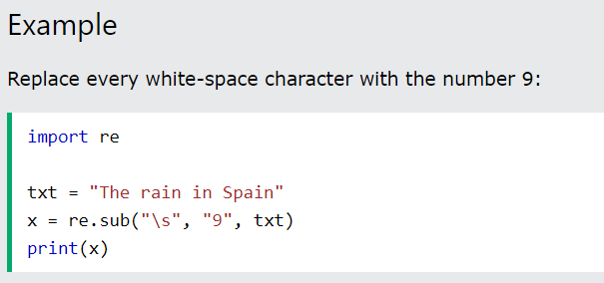
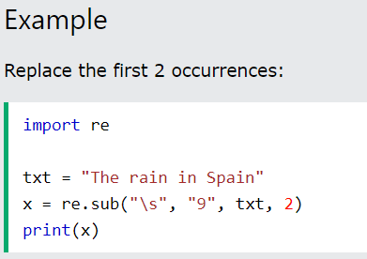
The sub() Function
The sub() function replaces the matches with the text of your choice:
You can control the number of replacements by specifying the count parameter:

Slide 30
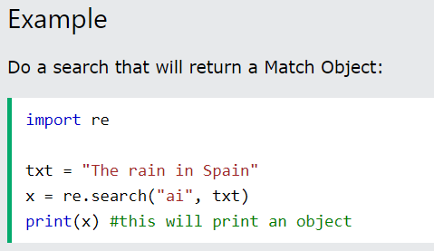
Match Object
A Match Object is an object containing information about the search and the result.
Note: If there is no match, the value None will be returned, instead of the Match Object.

Slide 31
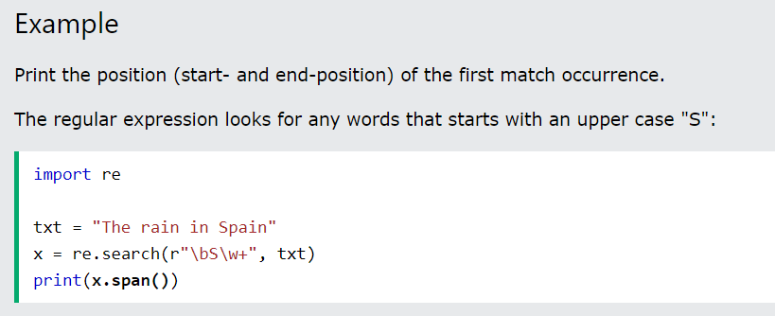
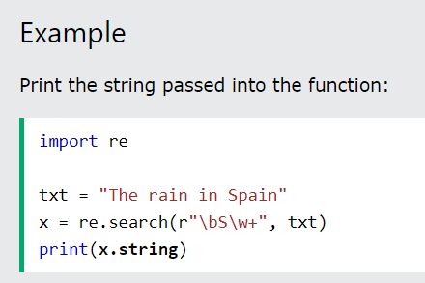
The Match object has properties and methods used to retrieve information about the search, and the result:
.span() returns a tuple containing the start-, and end positions of the match. .string returns the string passed into the function .group() returns the part of the string where there was a match
Note: If there is no match, the value None will be returned, instead of the Match Object.

